Slide 1
FORENSICS FAT12 INVESTIGATION
Eoin Dalton
20070289

Slide 2
Investigation Tools
As part of the investigation there were a number of tools used.
FTK Imager
SleuthKit
Active Disk Editor

Slide 3

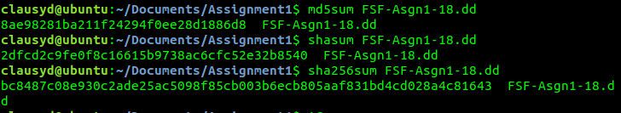
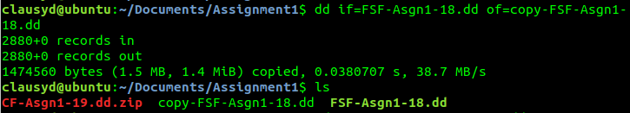
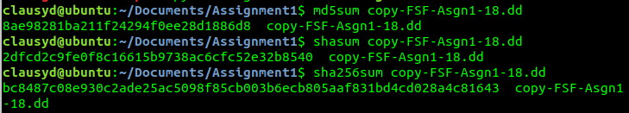
Securing the Evidence
In step 1:
Secure location
Original image verified through hash values
Forensic copies made
Hash values made taken of the copies and verified

Slide 4
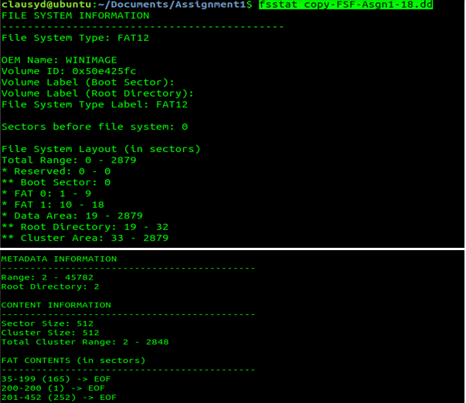
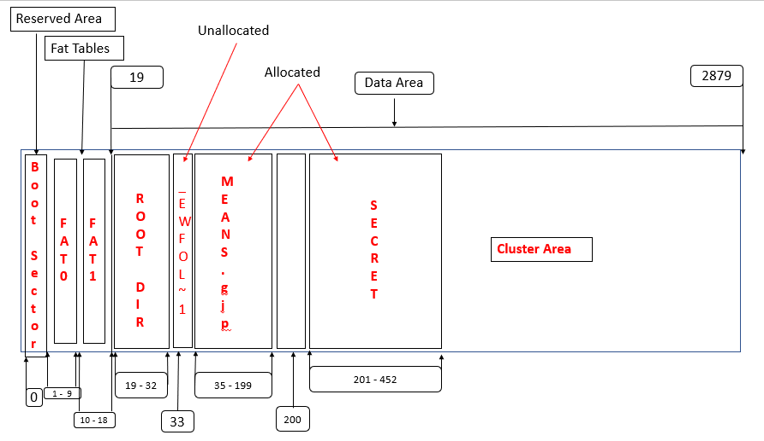
File System Data Structures
In step 2:
FAT12 file system was identified.
Data structure was established.

Slide 5
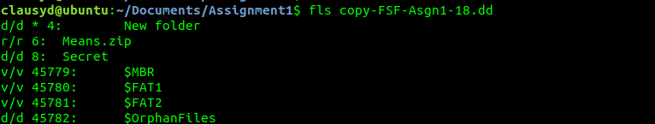
Recovering Files
In step 4:
Any files and directories where identified.

Slide 6
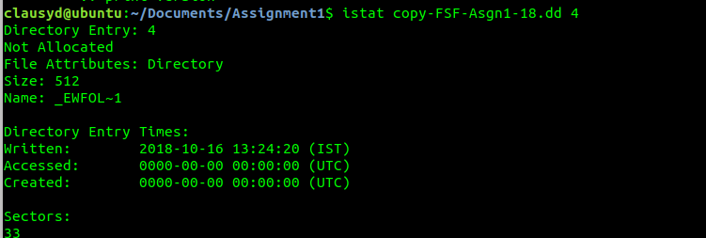
Deleted File
In step 5:
istat copy-FSF-Asgn1-18.dd 4

Slide 7
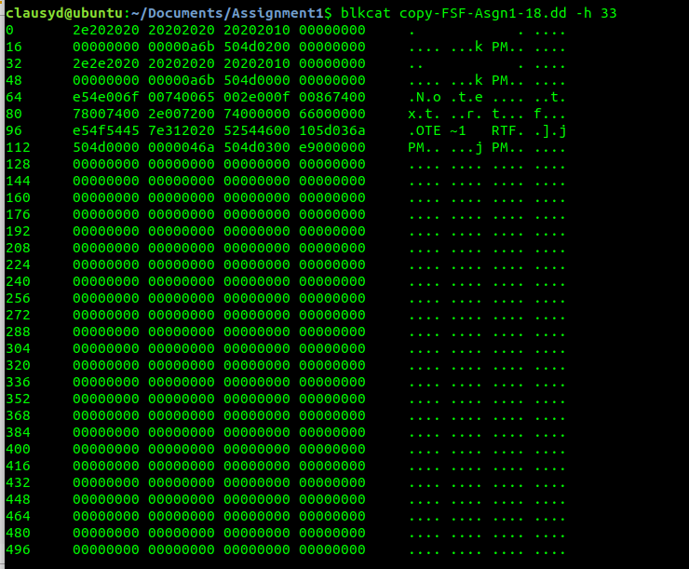
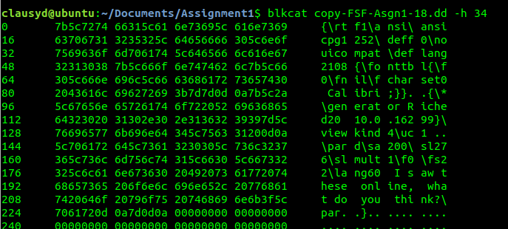
Deleted File
blkcat copy-FSF-Asgn1-18.dd -h 33
blkcat copy-FSF-Asgn1-18.dd -h 34

Slide 8
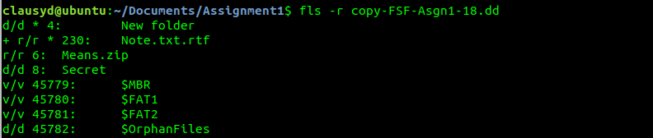
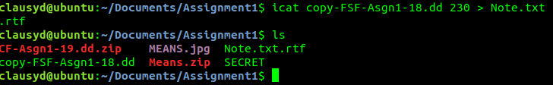
Deleted File
fls -r copy-FSF-Asgn1-18.dd
icat copy-FSF-Asgn1-18.dd 230 > Note.txt.rtf

Slide 9
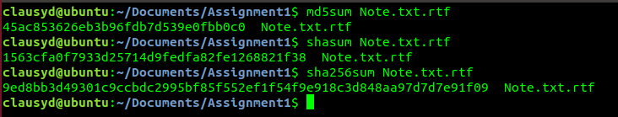
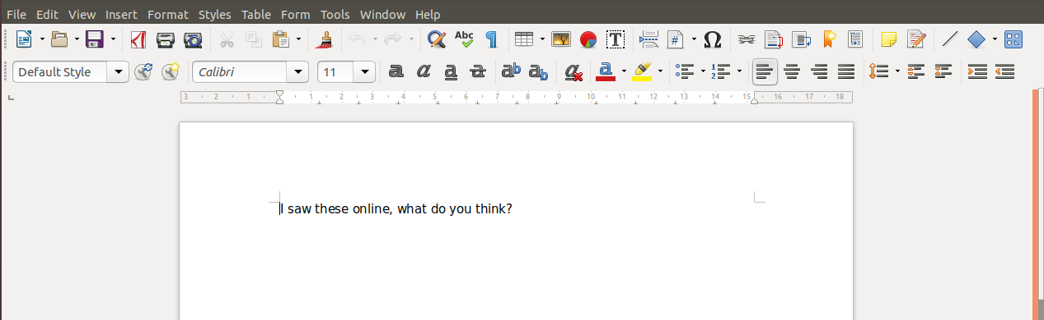
Deleted File
Hash values taken of recovered file.
Recovered File

Slide 10
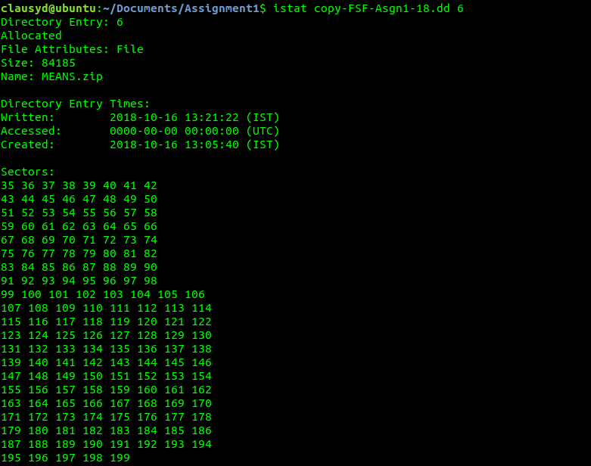
Mismatched File
In step 6
istat copy-FSF-Asgn1-18.dd 6

Slide 11
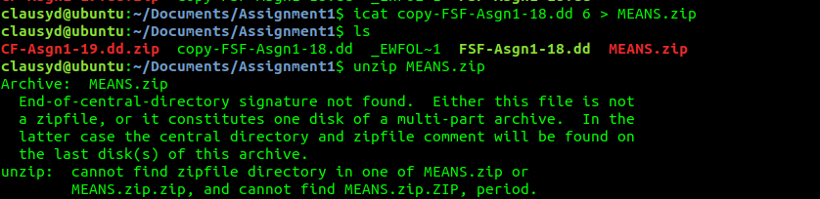
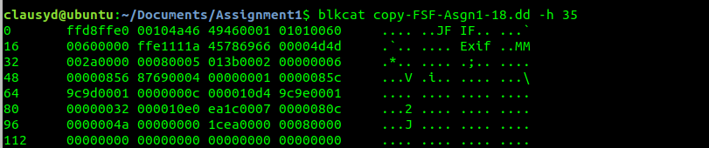
Mismatched File
icat copy-FSF-Asgn1-18.dd 6 > Means.zip
blkcat copy-FSF-Asgn1-18.dd -h 35

Slide 12
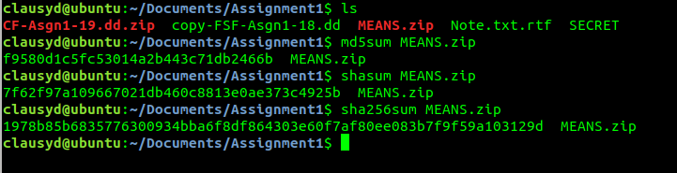
Mismatched File
file Means.zip
Hash values taken

Slide 13
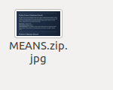
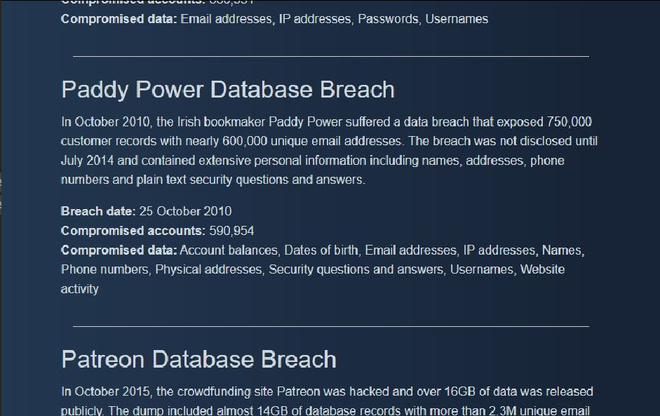
Mismatched File
Renaming the file
Recovered file

Slide 14
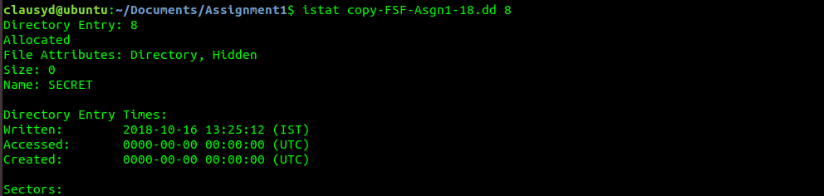
Allocated File
In step 7:
istat copy-FSF-Asgn1-18.dd 8
Using Data structure layout to identify file

Slide 15


Allocated File
Going back to the fsstat command to view the Fat Contents
Carving out the required sectors

Slide 16
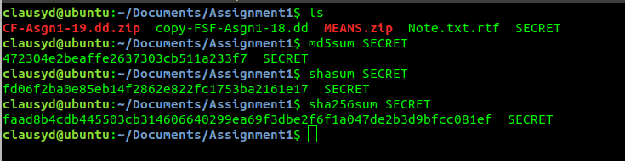
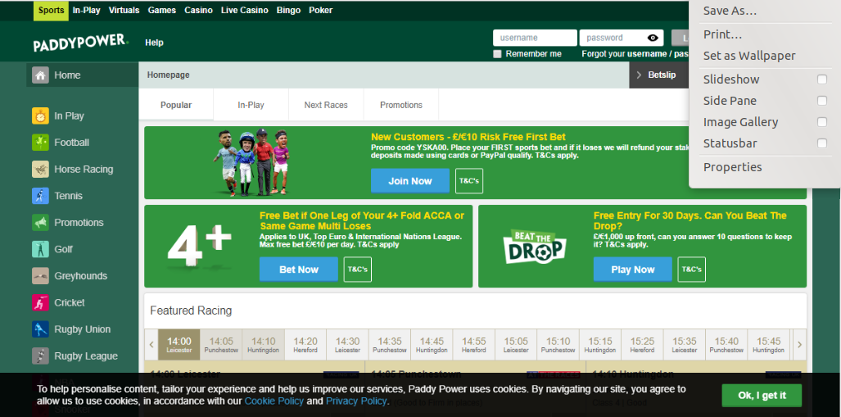
Allocated File
Listing working directory
Recovered file

Slide 17
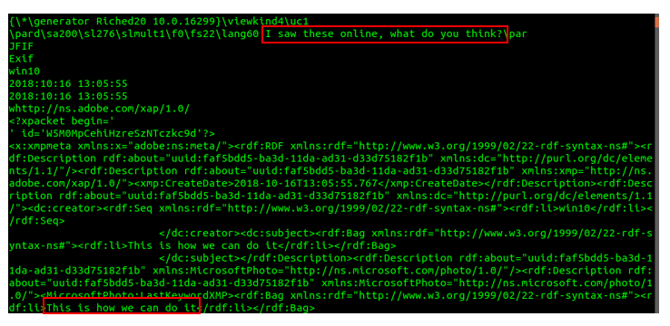
Other Command Used
strings copy-FSF-Asgn1-18.dd
Highlighted in red is some useful information.

Slide 18
Investigation Assessment
Brute force attack on Paddy Power website
Using unique email address obtained from data breach.

